Slide 1

Conway's Game of Life
http://pavolondzik.github.io/GoL/
Pavol Ondzik
Denzel Dadson

Slide 2
Task
Create interactive implementation of Conway’s Game of Life
User selects starting point for blinkers
System then sends gliders to destroy blinkers
OR
System randomly sets blinkers
Player sets starting point for gliders
System sends gliders from starting point
Notes:
Create an interactive implementation of the Game of Life grid, where a player can select starting points for a variety of blinkers. The system then sends gliders to destroy them, resulting in chaos. Alternatively, system randomly sets some blinkers and player sets starting point for gliders. Documentation should clearly explain algorithms used to generate the life-forms.

Slide 3
Cellular Automata
Emergence
Period
Speed
Rules

Slide 4
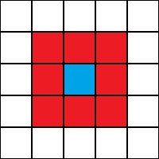
Conway's Game of Life
John Horton Conway, Scientific American (April 1970)
Cellular Automaton
Zero-player game
Field of cells, each has eight
neighbours ->
Moore neighbourhood.
A cell is either occupied (by an organism) or not.
Notes:
The three main components of a Cellular
Automata are:
➟The array dimension (Vast Parallelism: Cellular computing can
involve 10^5 or more cells)
➟The neighborhood structure (Locality)
➟The transition rule
(Simplicity): the basic processing element, the cell, is simple
is the smallest structural and functional unit of all living organisms, which has all the basic qualities of life. Jan Evangelista Purkyně,
Cellular Computing = simplicity + vast parallelism + locality

Slide 5









Rules for Conway’s Game of Life
Rules for deriving a generation from
the previous one :
Birth
Survival
Death
Notes:
A dead cell with exactly three live neighbours becomes a live cell (birth).
A live cell with two or three live neighbours stays alive (survival).
In all other cases, a cell dies or remains dead (overcrowding or loneliness).

Slide 6

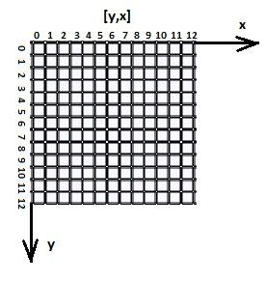
Patterns
Block (still life)
Blinker (period 2 oscillator)
Glider (spaceship)
Pulsar (period 3 oscillator)
Cartesian coordinate
system

Slide 7
Algorithm (1)
Notes:
Algorithm of the solution

Slide 8
Algorithm (2)

Slide 9
Thank you for your attention!
Do you have any questions ?

Slide 10
References
http://www.math.com/students/wonders/life/life.html
http://en.wikipedia.org/wiki/Conway%27s_Game_of_Life
http://www.julianpulgarin.com/canvaslife/

